Slide 1
PC Maintenance: Preparing for A+ Certification
Chapter 1: Computing Overview

Slide 2
Chapter 1 Objectives
Explain analog versus digital data
Explain input, processing, and output
Understand binary and decimal numbering
Identify key components of a PC
Differentiate between computer types
Understand BIOS, OS, and applications

Slide 3
What All Computers Have in Common
Digital Operation
Hardware and Software
User Input
Processing
Output

Slide 4
Analog
Continuously variable
No precisely defined values
Often associated with sound (waveforms)
Examples: radio, television broadcasts, telephone

Slide 5
Digital
Precise values
Numeric data
Quantifiable
Not continuously variable

Slide 6
Hardware and Software
Hardware: Physical parts of the computer
  Examples: Monitor, keyboard, mouse, CPU, disks
Firmware: a hardware chip with software stored on it
  Examples: BIOS chip, ROM storage of OS in a PDA
Software: Programming instructions for the hardware to execute

Slide 7
Binary Numbering
Two digits: 0 and 1
Native format for CPU processing of data
0 1

Slide 8
Decimal Numbering
Ten digits: 0 to 9
Standard numbering system for humans
0 1 2 3 4 5 6 7 8 9

Slide 9
Hexadecimal Numbering
Sixteen digits: 0 to 9 and A to F
Used for memory addresses
0 1 2 3 4 5 6 7 8 9 A B C D E F

Slide 10
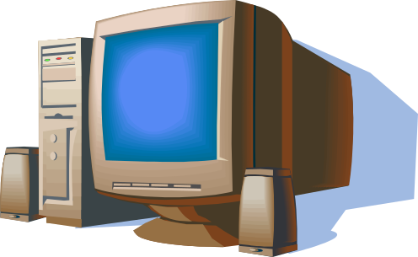
Input
Keyboard
NIC
Mouse
Microphone
Drives
Modem
Scanner
Digital Camera

Slide 11
Output
Monitor
NIC
Printer
Drives
Speakers
Modem

Slide 12
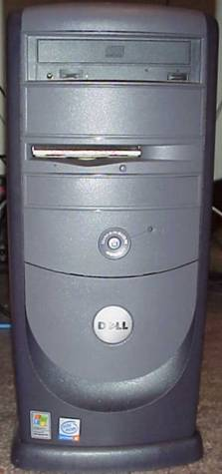
PC Exterior: Front
CD drive
Floppy drive
Hard disk light
Power button

Slide 13
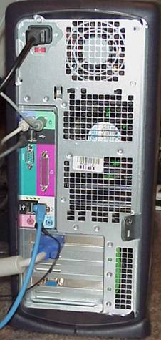
PC Exterior: Back
Power
Fan vent
Keyboard/mouse
Serial
USB
Parallel
Ethernet
Video
Sound

Slide 14
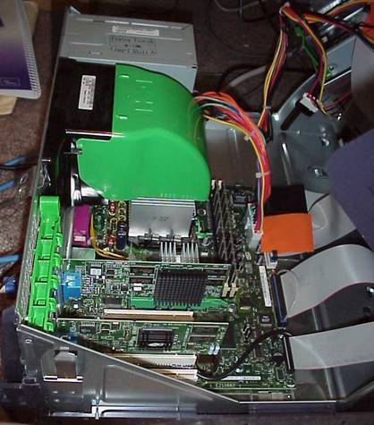
Key Components: Inside the PC
Power supply
Power supply connector to motherboard
CPU (under cooling block)
RAM
Ribbon cables from drives connect to motherboard
Expansion boards

Slide 15
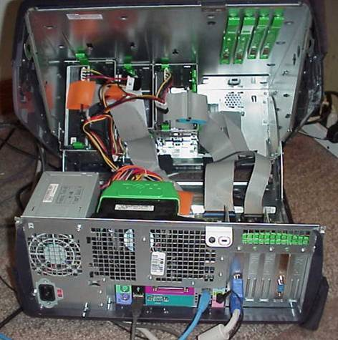
Key Components: Drive Bays
Drives
Ribbon cables connect drives to motherboard

Slide 16
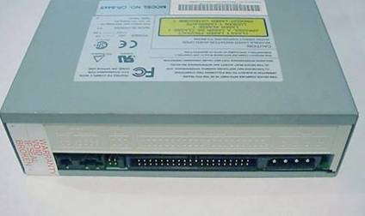
Key Components: Drives
Storage for data
Persists when power is off
Some can be externally accessed (floppy, CD)
Some are internal only (hard)
Ribbon cable
connector
Power
connector

Slide 17
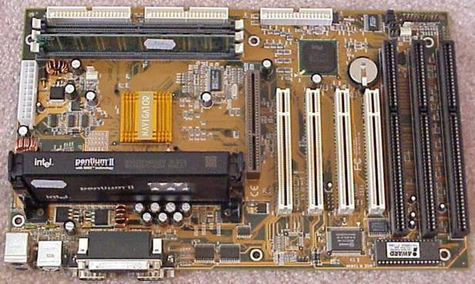
Key Components: Motherboard
IDE connectors
Battery
RAM
Power supply connector
ISA slots
CPU
Ports
AGP slot
PCI slots
BIOS chip

Slide 18
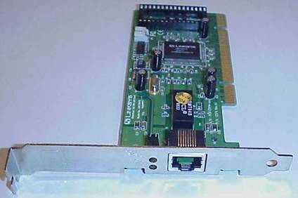
Key Components: Expansion Boards
Single-edge connector to motherboard
Add functionality to the PC that the motherboard does not provide
Fit into ISA, PCI, or AGP slots
Backplate
Externally accessible port

Slide 19
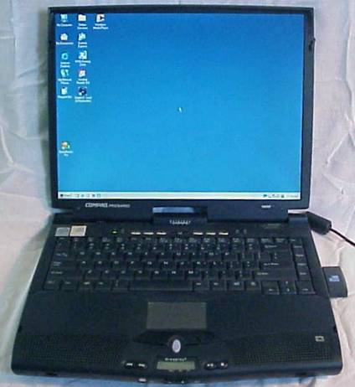
Notebook PCs
Can run on AC or battery
Built-in LCD screen
Built-in pointing device
PCMCIA slots instead of ISA/PCI

Slide 20
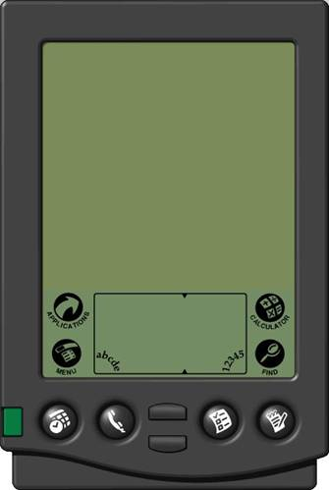
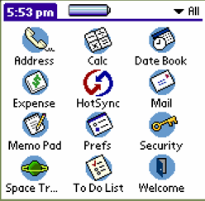
Personal Digital Assistant (PDA)
Hand-held computer
Limited amount of RAM
Limited in functionality
Write, tap with stylus on touch-sensitive screen

Slide 21
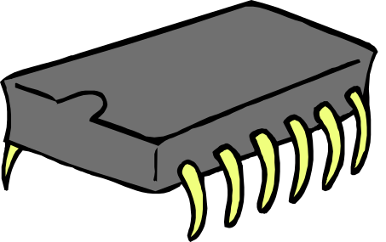
Basic Input Output
System (BIOS)
Startup instructions for low-level hardware
Typically on a chip on the motherboard
Does not change readily; requires special utility

Slide 22
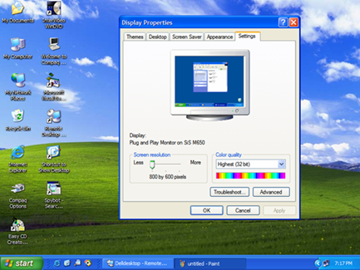
Operating System
Interacts with human user
Manages communication with software
Runs applications
Controls input and output

Slide 23
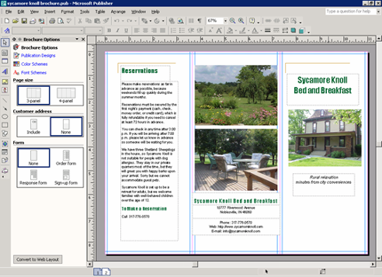
Applications
Perform useful human tasks
Run on top of an operating system
Are written for a specific OS
Examples: Word, Quicken, games

